Slide 1
Online Feedback System Khushbu Parekh(122) Neil Parmar(124) Shabnam Naviwala(146)

Slide 2
What is Feedback ?
Feedback is information received after completing a piece of work.
To get the opinion on the work performed.
Feedback helps you to know where do u lack
and what is expected from you.
Feedback helps in improving the quality of work and performance.

Slide 3
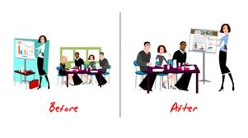
Feedback in college
Feedback is an essential part of learning.
Given by the students for the teacher.
The admin can make out the strong and the weak points of the teacher.
Check for the requirements of the students.
It gives a clear guidance on how to improve learning methods.

Slide 4

Online Feedback System
Feedback taken online
The online system contains a frontend and a backend
Frontend is for the students to fill the form
Backend is for the admin to obtain the results

Slide 5
Traditional Feedback System
Slow
More Employees
Calculation Error
Time Consuming
Not Ecofriendly
Some Subjects may not be entered
Students

Slide 6
Online Feedback System
Fast
Efficient
Less employees
Instant Results
Ecofriendly
Improved Results
Compulsory Feedback
Students

Slide 7
Application Description
Login Page
GR Number
Roll Number
Trimester
Division
Course
Branch
Subject Name
Teacher Name
Database

Slide 8
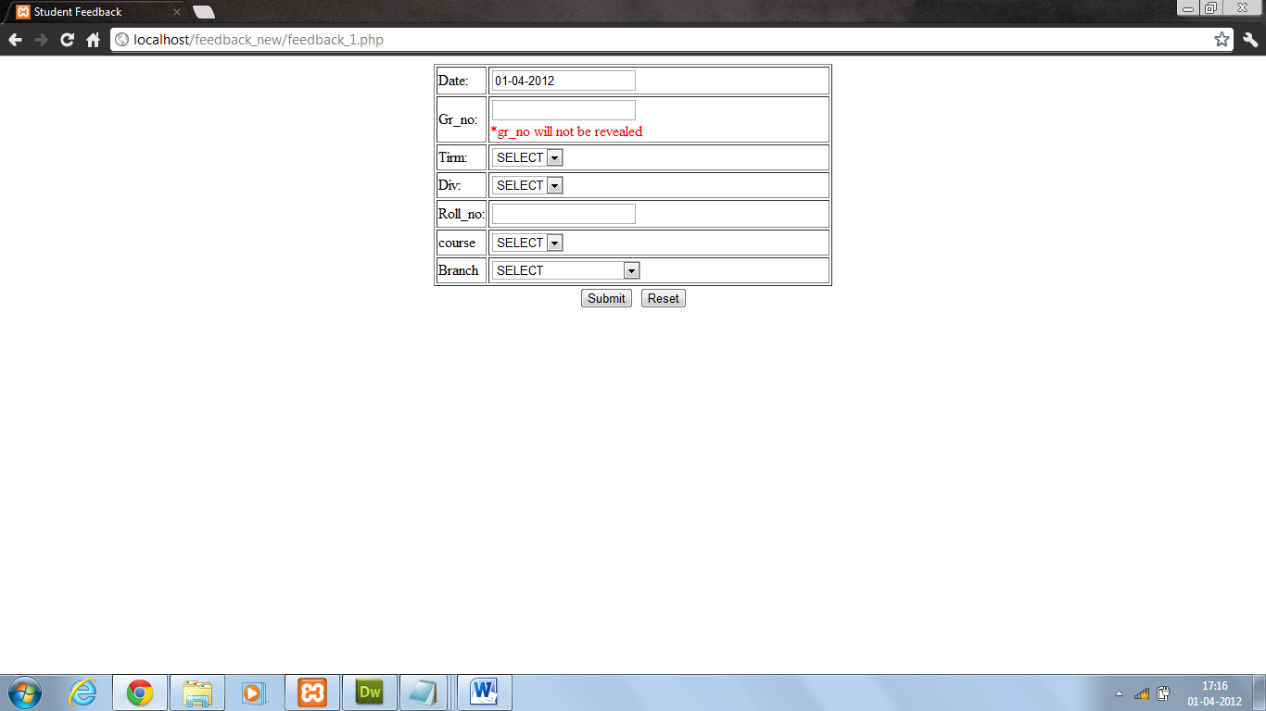

Slide 9
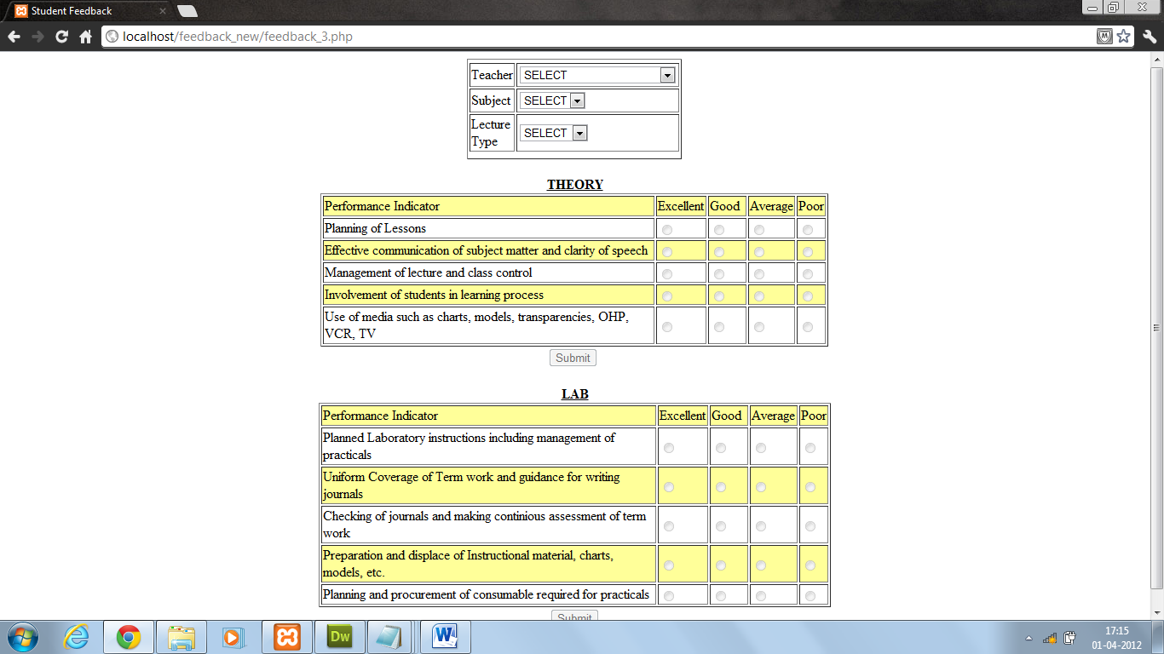

Slide 10
System Requirements
PHPMYADMIN
PHP version 5.3.8
MYSQL version 5
XAMPP
High speed LAN
Efficient Memory

Slide 11
PHPMYADMIN
Provided by XAMPP
Fast
Used over the Network
Stores data efficiently

Slide 12
PHP
Server-side Scripting Language
Free
Easy to implement
Fast, Secure
Be directly inserted into HTML

Slide 13
PHP
No Special Browser
No Special Plugin
Work Online through LOCALHOST
Compatibility
Supports MYSQL
No extensions

Slide 14
MYSQL
High Performance
Reliable
Platform Independent(about 20 platforms)
Encryption and Decryption functions
Secure

Slide 15
ER diagram
Theory Feedback
PL: Planning of Lessons
EC: Effective Communication
ML: Management of Lecture
IS: Involvement of Students
UM: Use of Media
Com: Comments
Lab Feedback
PL: Planned Lab
UC: Uniform Coverage
CJ: Checking of Journals
Pre: Preparations
Plan: Overall Planning
Com: Comments

Slide 16
First Name
Middle Name
Degree
Gr No
Name
Last Name
*:
*:
Student
Roll no
Teaches
Faculty Code
Teacher
Branch
Designation
*:
Givess
Takes
Com
Unique code
SubjectCode
For
plan
*:
Pre
Feedback Practical
Subject
CJ
UC
PL
SubjectName
Givess
Unique code
Com
IS
PL
Feedback Theory
For
EC
ML
UM

Slide 17
Database design
Integrity constraints used in the database design
Not null constraint - requires that a column of a table contain no null values.
Unique constraint - no two rows of a table have duplicate values in a specified column or set of columns.
Primary key - The primary key are also unique and not null.
Foreign key - The column or set of columns referenced by columns in other tables.

Slide 18
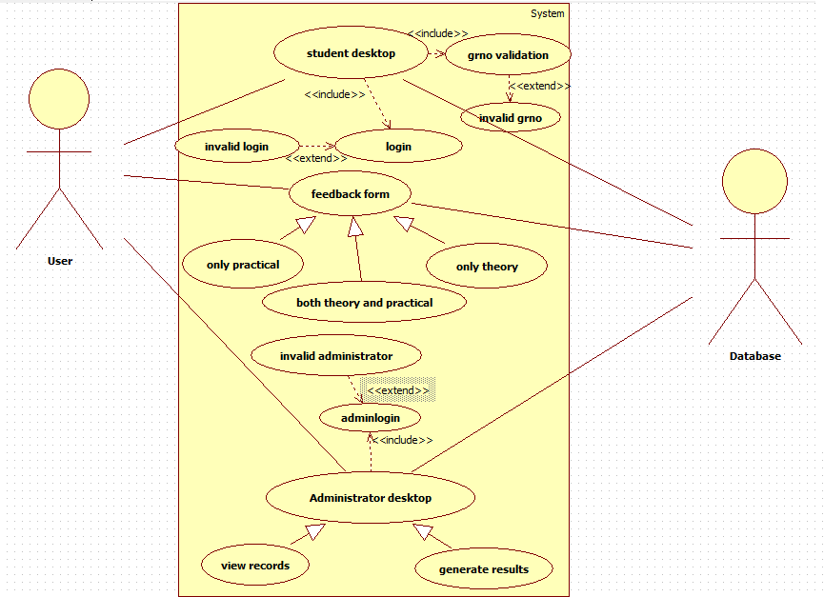
Use case Model

Slide 19
Future Scope
Feedback System’s data can be used for analyzing the strengths of institution.
Making feedback mandatory for each student
Looking forward to generalize the system so as to be used by various colleges.

